Slide 1
Connectors

Slide 2
Components
Genbrug
Arkitektonisk byggesten
Described by metadata
“a unit of composition with contracturally specified interfaces and explicit context dependencies only. A software component can be deployed independently and is subject to composition by third parties”
Vs. service

Slide 3
Connectors
Interaktion mellem komponenter
Ofte afgørende for kvaliteter (performance, reliability, scalability mm.)
Mange typer f.eks.
pipes
SQL links
shared memory
procedure call

Slide 4
Components + connectors
Almindeligt at opdele i components
Delvist understøttet i f.eks. Java og .Net
Connectors ofte skjult inde i selve komponenterne, tæt kobling
Ikke understøttet af Java
.Net har for nylig fået WCF, som i hvert fald delvist understøtter connectors
Kan en connector være en component?
arch.-as-designed <> arch.-as-implemented

Slide 5
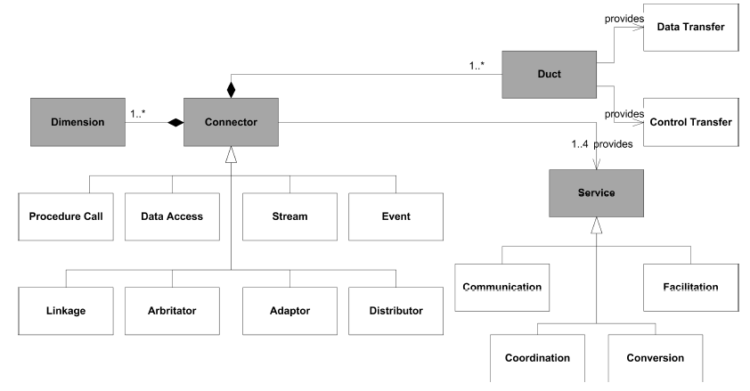
Ontologi [Mehta et al.]

Slide 6
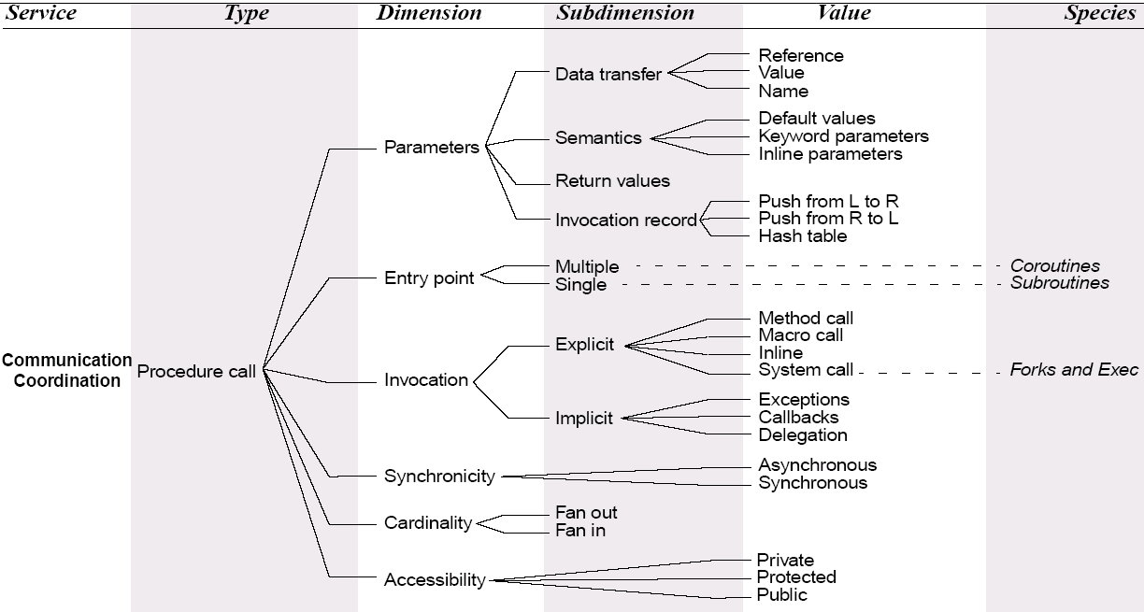
Procedure kald

Slide 7
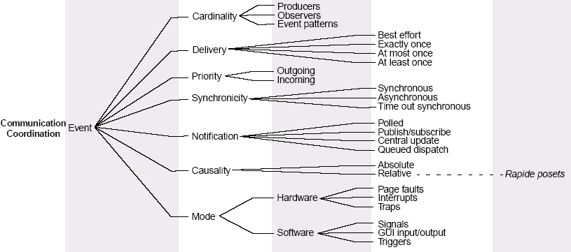
Events

Slide 8
First-class connectors
Komponenter bør ikke være afhængige af bestemte connectors
Bør dynamisk kunne skifte connector
Reflection
Self-* systems
ArchJava
extended Java
arch.-as-designed = arch-as-implemented
Port = two way interface, provides og requires

Slide 9
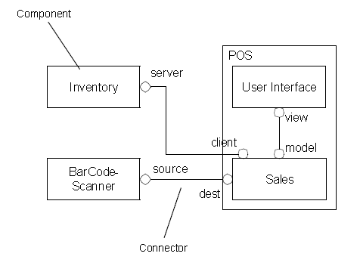
ArchJava

